Slide 2
Git introduction
Volodymyr Okhrym
23 Jan 2017

Slide 3
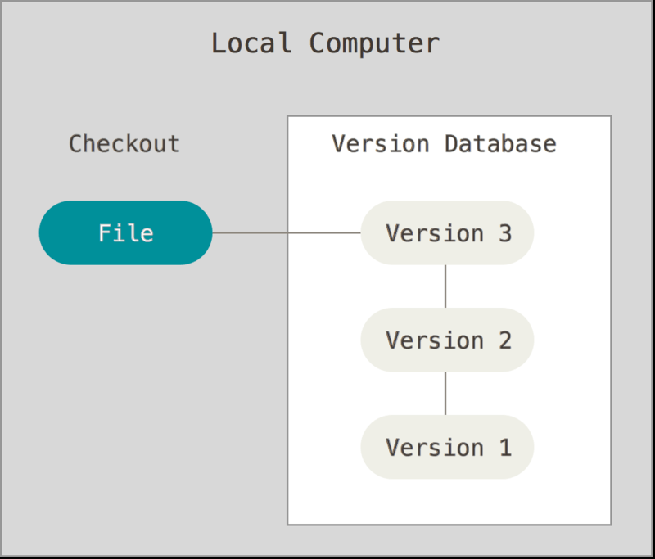
What is a Version Control System
+ Simple
- Bug-prone
- Makes it hard to
cooperate.

Slide 4
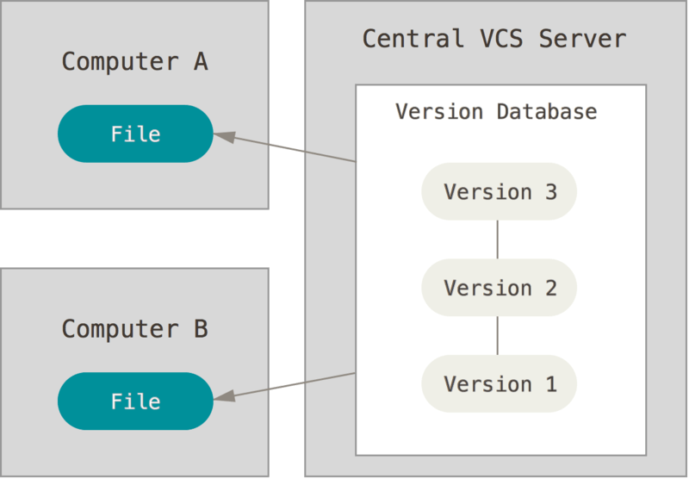
Centralized version control systems
+ Easy to understand
+ Easy to administer
+ You know what
everyone is doing.
- Slow
- Requires internet
connection
- Single point of failure.

Slide 5
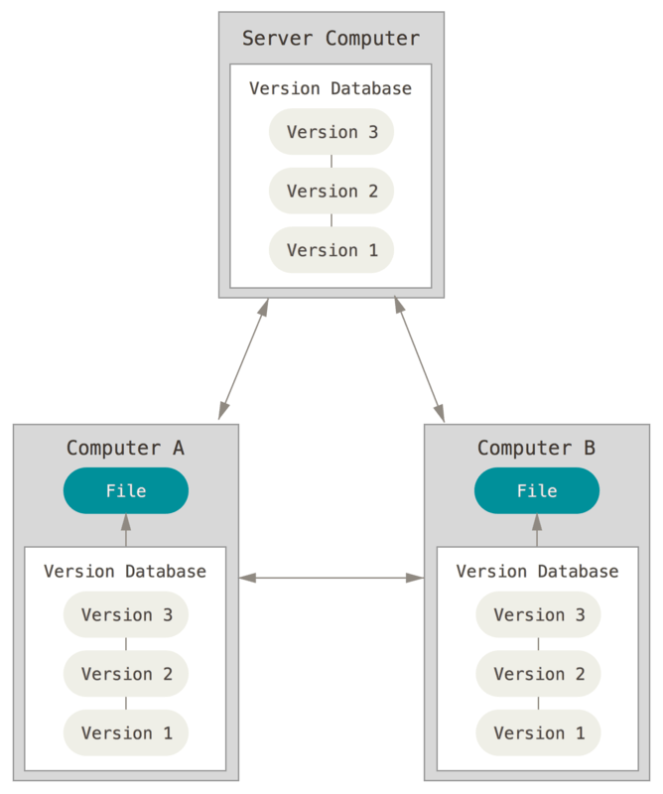
Distributed version control systems
+ Most of the operations are local
+ Extremely fast
+ It’s near impossible to shot yourself
in the leg
+ Multiple repositories.
- Not upfront intuitive.

Slide 6
QUESTIONS?
Notes:
Use the ”hilighted content” slide whenever you

Slide 7
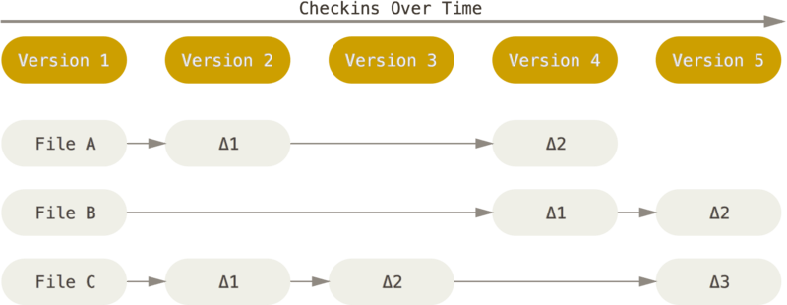
Other systems’ data model

Slide 8
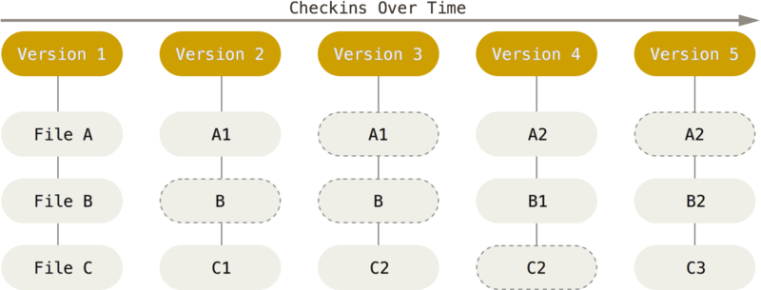
Git’s approach

Slide 9
Storage and SHAs
.git
SHA-1 for snapshots: 24b9da6552252987aa493b52f8696cd6d3b00373
Git mostly only adds data.

Slide 10
What Git client should I use?
Official command-line Git client
But generally it’s irrelevant, you can go for TortoiseGit/SourceTree. Just make sure whether your client has installed Git for you.

Slide 11
Git Commit
Without the commit the info is not recorded in the repo, we commit with ‘git commit’ command
Commits should be atomic.

Slide 12
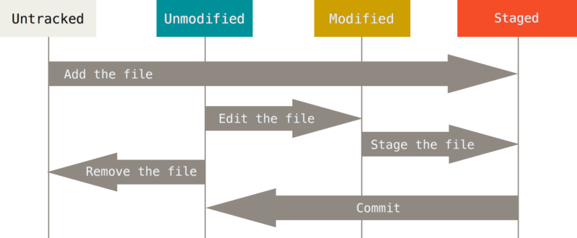
File states
File in Git can be either:
Untracked – Git sees it in the repository but knows nothing about it
Staged – It was added to the staging area with ‘git add’
Unmodified – Normal unchanged file in the repository
Modified(Deleted/Renamed) – File from the repository was modified.

Slide 13
Git status
$ git status
…
Changes to be committed:
(use "git reset HEAD <file>..." to unstage)
new file: README
Changes not staged for commit:
(use "git add <file>..." to update what will be committed)
(use "git checkout -- <file>..." to discard changes in working directory)
modified: CONTRIBUTING.md

Slide 14
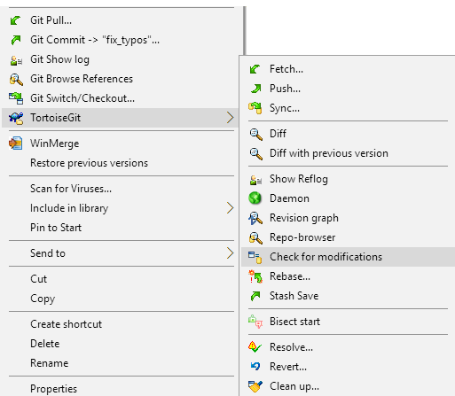
TortoiseGit status

Slide 15
Ignoring files
.gitignore holds all the files that should be ignored.

Slide 16
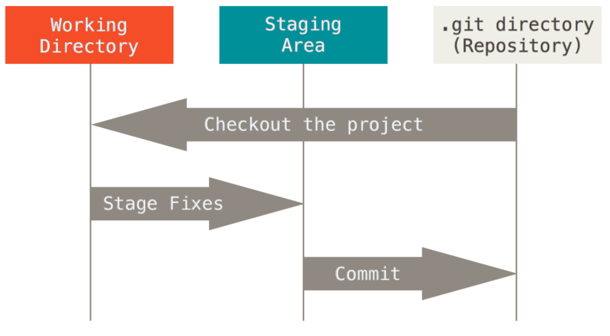
Directories terminology
Working directory /
Working tree
Staging area /
Index
.git directory

Slide 17
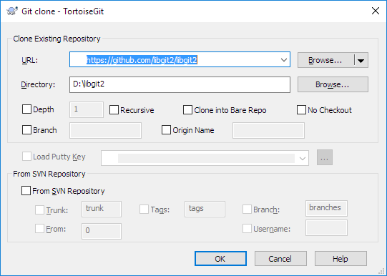
Git Clone
git clone https://github.com/libgit2/libgit2

Slide 18
QUESTIONS?
Is it possible to get back the file that was deleted a long time ago?
With which command do we introduce changes to the repository?
How to move a file to the staging area?
What is .gitignore for?
Notes:
Use the ”hilighted content” slide whenever you

Slide 19
Summary
I understand how to clone a repository and why I need to do this. I know how to add new files to the repository, modify the existing ones and commit that to the repository.

Slide 20
QUESTIONS?
Notes:
Use the ”hilighted content” slide whenever you

Slide 21
Homework
- Create your own repository on the GL’s Gitlab
- Clone it
- Add files, make a commit
- Ignore all .test files, create a few to verify it works
- Add 5 files, after that commit first 3 of them and after that the other 2
- Learn to unstage files
- Try ignoring already committed files
Notes:
Use the ”hilighted content” slide whenever you

Slide 22
Thank you
Volodymyr Okhrym
Volodymyr.okhrym@globallogic.com
+38093-694-51-84
Skype: diocin

